Slide 1
Tsallis Entropy & Big Data
Wagish Kumar Rai
Supervisor: Assoc Prof Chew Lock Yue

Slide 2
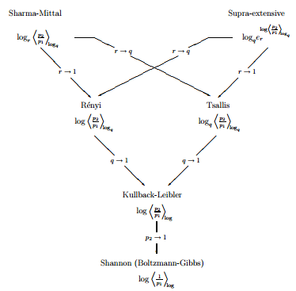
http://farxiv.org/pdf/cond-mat/0611300v2.p

Slide 3
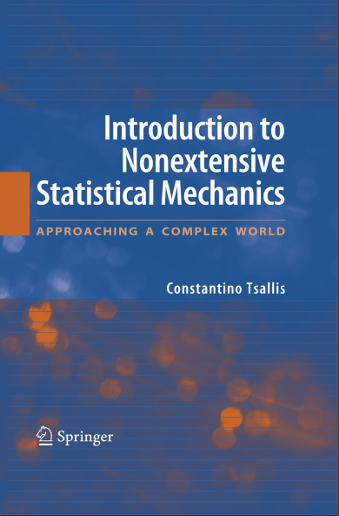



Constantino Tsallis - Tsallis Entropy
Possible generalization of Boltzmann–Gibbs statistics J.Statistical Physics
(1988)

Slide 4
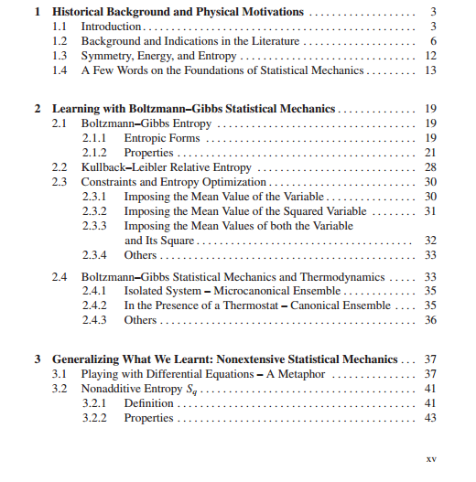

Slide 5
Key Motivations
Quasi-stationary states (QSS) long-range interacting Hamiltonian systems - BG Statistics fails. Tsallis statistics is verified to characterise QSS.
If, however, SBG is not universal, how to generalize it? No logical-deductive path ever existed for proposing a new physical theory, or for generalizing a pre-existing one. In fact, such proposal frequently — perhaps always — occurs on a metaphorical basis. [1] - C. Tsallis

Slide 6
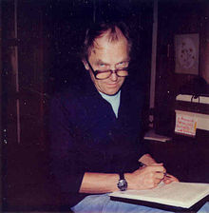
Paul Feyerabend
Against Method (1975)
Philosophy of Science & Sociology of Scientific Knowledge
Anarchist view of Science: Rejects Existence of Universal methodological rules

Slide 7

“Leetaru's work made the news in 2011, as it claimed to pick up early clues to where the al-Qaeda leader had been living in Pakistan, just from publicly available sources of information.”
“For science, it makes sense to see big data as a revolution. Algorithms will spot patterns and generates theories, so there's a decreasing need to worry about inventing a hypothesis first and then testing it with a sample of data.”
“Big Data is about finding patterns, not truth”

Slide 8
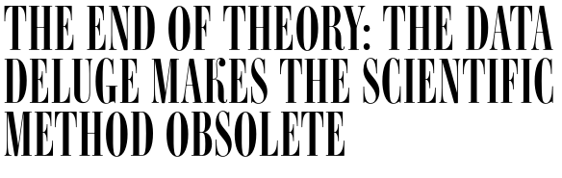
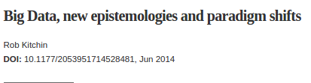

Slide 9
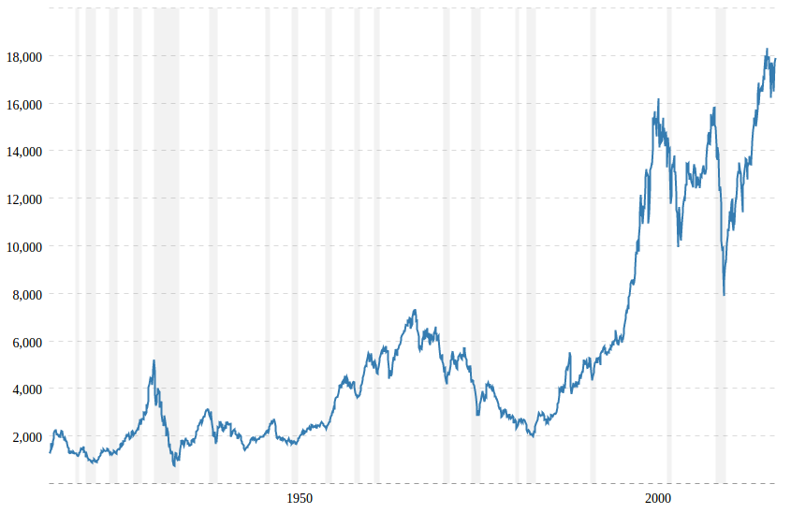
Dow Jones - 100 Year Historical Chart

Slide 10
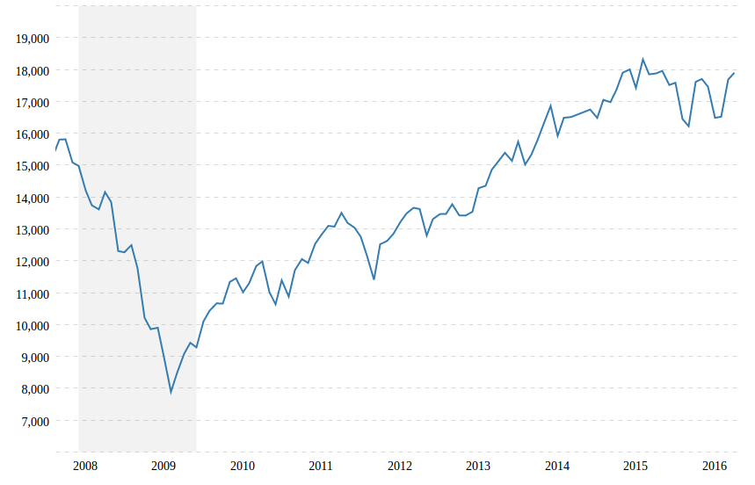
Dow Jones 2007 - 2008 Financial Crisis

Slide 11
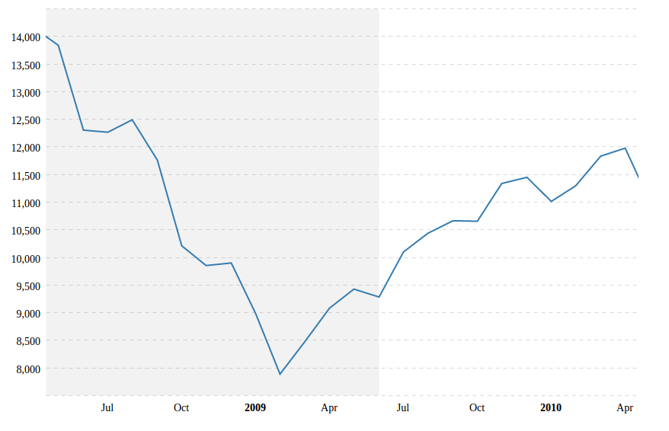
Twitter Data Set - Time Scale

Slide 12

Twitter
Twitter was launched in July 2006
Social Networking service that enables users to send and read short 140-character messages called "tweets".
The service rapidly gained worldwide popularity, with more than 100 million users posting 340 million tweets a day in 2012.

Slide 13




Twitter in General

Slide 14
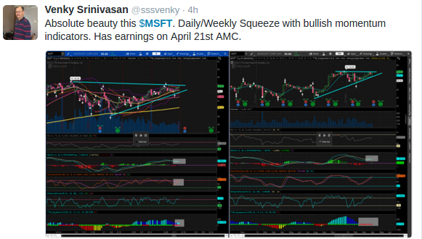
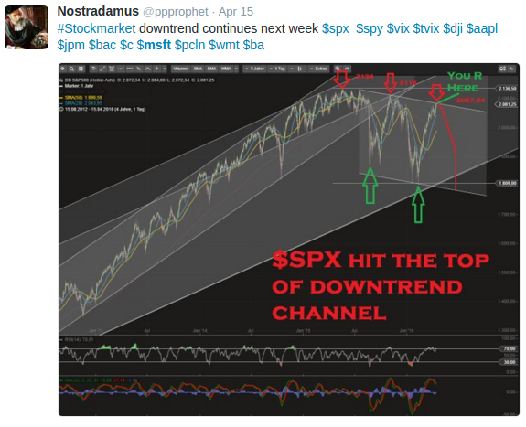

Twitter - Financial Tags e.g. MSFT

Slide 15
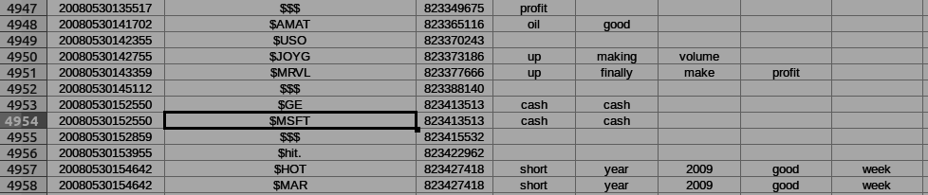
Pre-processed Twitter Data
2008 / 05 / 30
hh:mm:ss
Financial Tag(s) from twitter messages
ID
Filtered Messages (used for Sentiment Analysis)

Slide 16
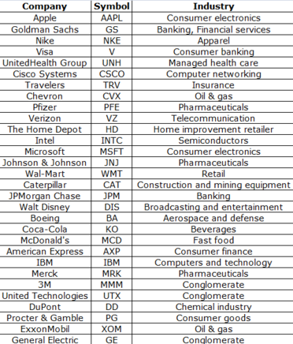
DOW 30 Symbols

Slide 17
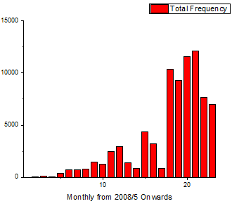

Slide 18
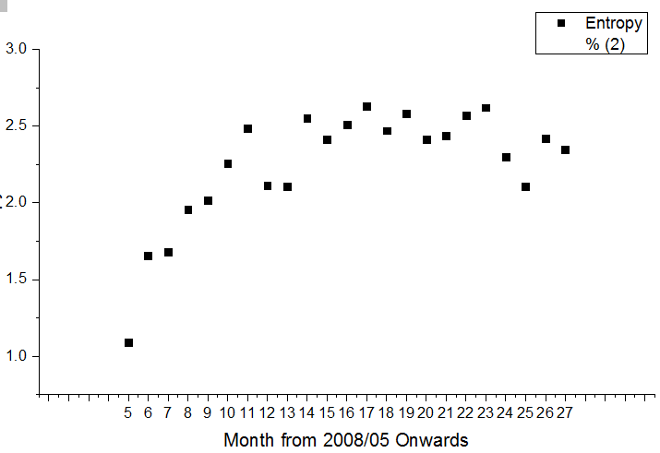
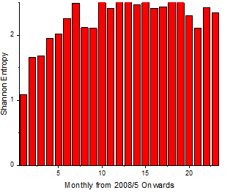

Slide 19
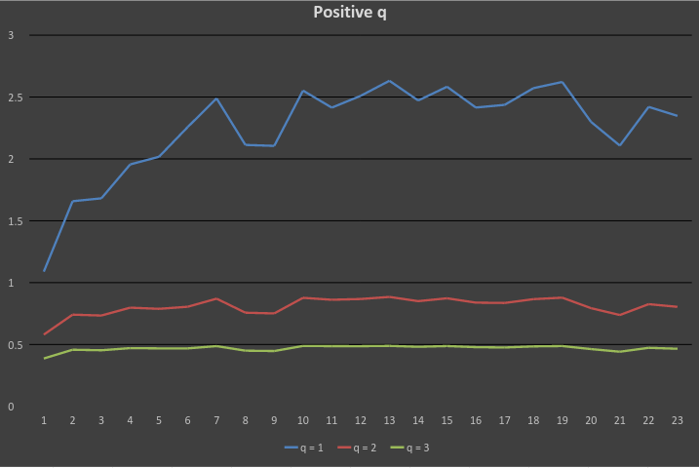

Slide 20
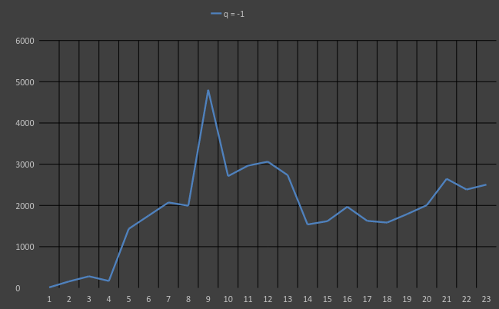
q = -1

Slide 21
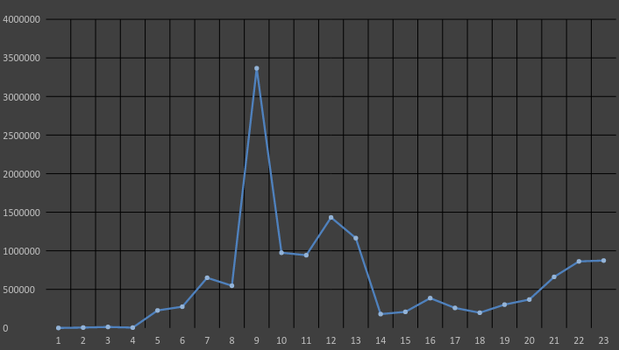
q = -2

Slide 22
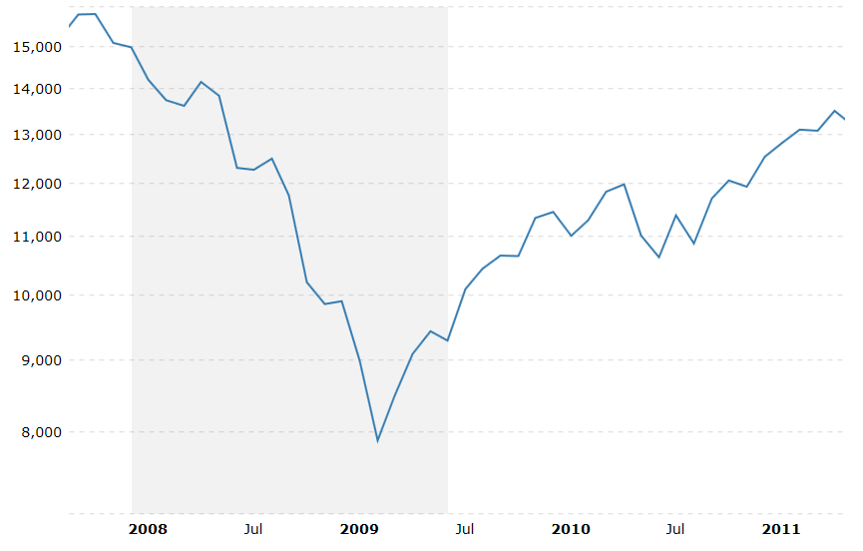
Negative q peak occurs at Jan 2009

Slide 23
References
[1] C. Tsallis, J. Stat. Phys. 52, 479 (1988).
[2] Constantino Tsallis, Edgardo Brigatti. Nonextensive statistical mechanics: A brief introduction. (2003)
[3] https://www.youtube.com/watch?v=Id7_qE0dCYs
[4] http://farxiv.org/pdf/cond-mat/0611300v2.p
[5] http://www.wired.co.uk/news/archive/2013-01/25/big-data-end-of-theory
[6] A. Pluchino1 A. Rapisard and C. Tsallis. Nonergodicity and Central Limit Behavior in Long-range Hamiltonians.

